Slide 1
CSP554 Big Data Technologies
Module 07
Spark SQL (DataFrames)

Slide 2
Spark Data Abstractions
Spark has several core abstractions
Datasets
DataFrames
SQL Tables
Resilient Distributed Datasets (RDDs)
These abstractions all represent distributed collections of data however they have different interfaces for working with that data
The easiest and most efficient are DataFrames and SQL Tables

Slide 3
Spark SQL
The Hive project was instrumental in providing the pattern of SQL-like access to unstructured data in HDFS…
But performance and user experience clearly fell well short of database systems
The batch nature of MapReduce, which is the processing engine behind Hive, was not suited to interactive queries or real-time applications
Spark SQL provides an SQL abstraction to its RDD-based storage, scheduling, and execution model
Many key characteristics of core Spark are inherited by Spark SQL
Including lazy evaluation and mid-query fault tolerance
Moreover, Spark SQL can be used in conjunction with the Spark core API within a single application.

Slide 4
Spark SQL
One use of Spark SQL is to execute SQL queries written using either a basic SQL syntax or HQL
Spark SQL can also be used to read data from an existing Hive files
You interact with the SQL interface using the command line or via JDBC/ODBC
The whitepaper titled “Spark SQL: Relational Data Processing in Spark” is recommended further reading

Slide 5
DataFrame
A DataFrame is the most common Structured API and simply represents a table of data with rows and columns
The list of columns and the types in those columns the schema
A simple analogy would be a spreadsheet with named columns
The fundamental difference is that while a spreadsheet sits on one computer in one specific location, a Spark DataFrame can span thousands of computers
Each record in a DataFrame must be of type Row
The DataFrame itself can be considered as contained an Array where each entry is of type Row

Slide 6
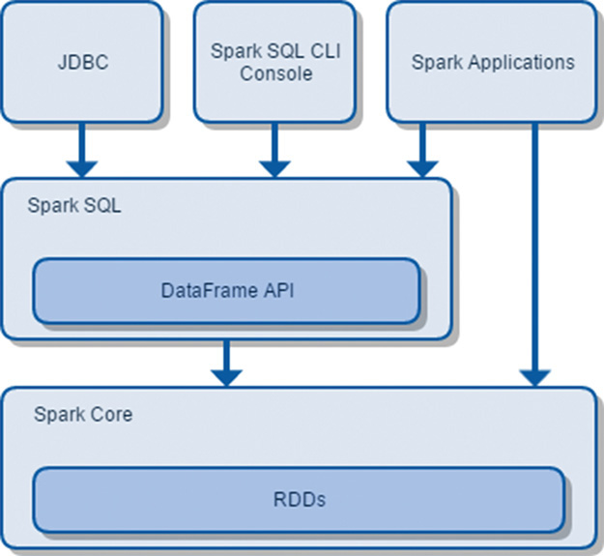
Spark SQL Architecture

Slide 7
Performance & Scalability
In 2009, the 100 TB GraySort benchmark was created in honor of Jim Gray
Yahoo won the 2013 record using a 2100-node Hadoop cluster, sorting 100 TB of data in 72 minutes while using MapReduce
In 2014, Databricks entered the competition using a distributed sorting program built on top of Spark
Its system sorted 100 TB of data in 23 minutes, using only 207 machines on EC2
That is to say, Spark sorted the same data 3X faster using 10X fewer resources than the 2013 Hadoop entry

Slide 8
Performance & Scalability
Spark SQL includes a cost-based optimizer, columnar storage and code generation to make queries fast
At the same time, it scales to thousands of nodes and multi hour queries using the Spark engine
Further the Spark engine provides full mid-query fault tolerance

Slide 9
An End to End Example
Here will will work an example step by step using some flight data available here from the United States Bureau of Transportation statistics
Here is a same of the file including the header row with column labels and a few data rows
DEST_COUNTRY_NAME,ORIGIN_COUNTRY_NAME,count
United States,Romania,15
United States,Croatia,1
United States,Ireland,344

Slide 10
An End to End Example
Spark includes the ability to read and write from a large number of data sources
In order to read this data in, we will use a DataFrameReader that is associated with our SparkSession
In doing so, we will specify the file format as well as any options we want to specify
In our case, we want to do something called schema inference, we want Spark to take the best guess at what the schema of our DataFrame should be.
We also want to specify that the first row is the header in the file, we’ll specify that as an option too.
To get this information Spark will read in a little bit of the data and then attempt to parse the types in those rows according to the types available in Spark
flightData2015 = spark\
.read\
.option("inferSchema", "true")\
.option("header", "true")\
.csv(”hdfs:///mnt/defg/flight-data/csv/2015-summary.csv")

Slide 11
An End to End Example
Each of these DataFrames have a set of columns with an unspecified number of rows
The reason the number of rows is “unspecified” is because reading data is a transformation, and is therefore a lazy
Operation
Spark only peeked at a couple of rows of data to try to guess what types each column should be
If we perform the take action on the DataFrame, we will be able to see the results
flightData2015.take(3)
Array([United States,Romania,15], [United States,Croatia...

Slide 12
An End to End Example
Let’s specify some more transformations!
Now we will sort our data according to the count column which is an integer type
Nothing happens to the data when we call sort because it’s just a transformation
However, Spark is building up a plan for how it will execute this across the cluster
Now, just like we did before, we can specify an action in order to kick off this plan
However before doing that, we’re going to set a configuration
By default, when we perform a shuffle Spark will output two hundred shuffle partitions
We will set this value to five in order to reduce the number of the output partitions from the shuffle
spark.conf.set("spark.sql.shuffle.partitions", "5")
flightData2015.sort("count").take(2)
... Array([United States,Singapore,1], [Moldova,United States,1])

Slide 13
An End to End Example
This operation is illustrated in the following image
In addition to the logical transformations, we include the physical partition count as well

Slide 14
DataFrames and SQL
Spark SQL allows you to register any DataFrame as a table and query it using pure SQL
There is no performance difference between writing SQL queries or writing DataFrame code
They both “compile” to the same underlying plan
Any DataFrame can be made into a table or view with one simple method call
flightData2015.createOrReplaceTempView("flight_data_2015")
Now we can query our data in SQL
To execute a SQL query, we’ll use the spark.sql() function that returns a new DataFrame
While this may seem a bit circular in logic that a SQL query against a DataFrame returns another DataFrame, it’s actually quite powerful
As a user, you can specify transformations in the manner most convenient to you at any given point in time and not have to trade any efficiency to do so

Slide 15
DataFrames and SQL
sqlWay = spark.sql("""
SELECT DEST_COUNTRY_NAME, count(1)
FROM flight_data_2015
GROUP BY DEST_COUNTRY_NAME
""")
dataFrameWay = flightData2015\
.groupBy("DEST_COUNTRY_NAME")\
.count()

Slide 16
DataFrames and SQL
maxSql = spark.sql("""
SELECT DEST_COUNTRY_NAME, sum(count) as destination_total
FROM flight_data_2015
GROUP BY DEST_COUNTRY_NAME
ORDER BY sum(count) DESC
LIMIT 5
""")
maxSql.collect()
from pyspark.sql.functions import desc
flightData2015\
.groupBy("DEST_COUNTRY_NAME")\
.sum("count")\
.withColumnRenamed("sum(count)", "destination_total")\
.sort(desc("destination_total"))\
.limit(5)\
.collect()

Slide 17
Using Spark SQL (DataFrames)
Python API docs
https://spark.apache.org/docs/2.4.3/api/python/index.html
Use ‘Quick Search’ to find the operation for which you are looking
Or see “Spark – Python API – SQL & DataFrames” on the blackboard in the “Free Books and Chapters” section

Slide 18
Using Spark SQL (DataFrames)
pyspark.sql.SparkSession
Main entry point for DataFrame and SQL functionality
A SparkSession can be used to…
Create DataFrame
Execute SQL over tables
Cache tables

Slide 19
Using Spark SQL (DataFrames)
pyspark.sql.DataFrameReader
Interface used to load a DataFrame from external storage systems Use SparkSession.read() to access this
pyspark.sql.DataFrameWriter
Interface used to write a DataFrame to external storage system
Use DataFrame.write() to access this.

Slide 20
Using Spark SQL (DataFrames)
pyspark.sql.DataFrame
A distributed collection of data grouped into named columns
A DataFrame is equivalent to a relational table in Spark SQL
Can register a DataFrame as table
pyspark.sql.Row
A row of data in a DataFrame
pyspark.sql.StructType
Defines the schema od (each Row in) a DataFrame
pyspark.sql.StructField
Defines the name and type of a filed in (each Row in) a DataFrame
pyspark.sql.types
List of data types available for each StructField

Slide 21
SparkContext and SparkSession
SparkContext was the main entry point for an application using the Spark Core API
In pyspark an instance of SparkContext is available and called ‘sc’
SparkSession is the main entry point for Spark SQL (and Spark DataFrames)
In pyspark an instance of SparkSession is available and called ‘spark’

Slide 22
DataFrame API
In a previous lecture, you learned how to manipulate RDDs
This is important because RDDs represent a low-level, direct way of manipulating data in Spark and the core of Spark runtime
Spark 1.3 introduced the DataFrame API for handling structured, distributed data in a table-like representation with named columns and declared column types

Slide 23
DataFrame API
A DataFrame is an RDD that has a schema
You can think of it as a relational database table, in that each column has a name and a known type
The power of DataFrames comes from the fact that, when you create a DataFrame from a structured dataset…
Spark is able to infer a schema by making a pass over the entire dataset that’s being loaded
When calculating the execution plan, Spark can use the schema and do better computation optimizations
Alternatively you can programmatically associate a schema with a DataFrame

Slide 24
DataFrame API
DataFrames can be constructed from a wide range of sources including…
An existing RDD
A JSON file
A text file, Parquet file, or ORC file
A table in Hive
An external database

Slide 25
DataFrame API
As an example, the following creates a DataFrame based on the content of a JSON file:
df = spark.read.json(”hdfs://examples/src/main/resources/people.json")
# Displays the content of the DataFrame to stdout
df.show()

Slide 26
DataFrame API
DataFrames translate SQL code and domain-specific language (DSL) expressions into optimized low-level RDD operations…
So that the same API can be used from any supported language (Scala, Java, Python, and R) for accessing any supported data source (files, databases, and so forth) in the same way and with comparable performance characteristics
Since their introduction, DataFrames have become one of the most important features in Spark and made Spark SQL the most actively developed Spark component
Since Spark 2.0, DataFrame is implemented as a special case of DataSet.

Slide 27
DataFrame API
SQL is so ubiquitous that the DataFrame API quickly met with acclamation by the wider Spark community
It allows you to attack a problem from a higher vantage point when compared to Spark Core transformations
The SQL-like syntax lets you express your intent in a more declarative fashion…
You describe what you want to achieve with a dataset, whereas with the Spark Core API you basically specify how to transform the data (to reshape it so you can come to a useful conclusion)
You may therefore think of Spark Core as a set of fundamental building blocks on which all other facilities are built
The code you write using the DataFrame API gets translated to a series of Spark Core transformations under the hood.

Slide 28
Interoperating with RDDs
Recall that one distinction between RDDs and DataFrames is that the later have a schema
Spark SQL supports two different methods for converting existing RDDs into DataFrames and supplying a schema
The first method uses reflection to infer the schema of an RDD that contains specific types of objects
This reflection based approach leads to more concise code and works well when you already know the schema
The second method for creating DataFrames is through a programmatic interface
This allows you to construct a schema and then apply it to an existing RDD

Slide 29
Interoperating with RDDs
The main function used to create DataFrames from RDDs is the createDataFrame method, which is described here
SparkSessiont.createDataFrame(data,
schema=None,
samplingRatio=None)
The createDataFrame method creates a DataFrame object from an existing RDD
The data argument is a reference to a named RDD object consisting of tuples or list elements
The schema argument refers to the schema to be projected to the DataFrame object
samplingRatio is used to sample the data if the schema is to be inferred

Slide 30
Schemas
A schema defines the column names and types of a DataFrame
We can either let a data source define the schema or we can define it explicitly ourselves
The function schema returns the schema associated with a DataFrame (whether Spark inferred or we provided the schema definition)
spark.read.format(“json”)\
.load(“hdfs:///user/hadoop/2015-summary.json”)\
.schema

Slide 31
Schemas
Python will return
StructType(
List (
StructField(DEST_COUNTRY_NAME, StringType, true),
StructField(ORIGIN_COUNTRY_NAME, StringType, true),
StructField(count, LongType, true)
)
)
A schema is a StructType made up of a number of fields called StructFields
That provide a name, type, and a Boolean flag which specifies whether or not that column can contain missing or null values
Column Name Column Type Null Allowed?

Slide 32
Schemas
Here’s how to create, and enforce a specific schema on a DataFrame
If the types in the data (on read), do not match the schema then Spark will throw an error
from pyspark.sql.types import StructField, StructType, StringType, LongType
myManualSchema = StructType([
StructField(“DEST_COUNTRY_NAME”, StringType(), True),
StructField(“ORIGIN_COUNTRY_NAME”, StringType(), True),
StructField(“count”, LongType(), False)
])
df = spark.read.format(“json”)\
.schema(myManualSchema)\
.load(“/hdfs:///user/hadoop/2015-summary.json”)

Slide 33
Inferring the Schema Using Reflection
Spark SQL can convert an RDD of Row objects to a DataFrame, inferring the datatypes
Using SparkSession.createDataFrame(someRDD)
But the RDD must be composed of Row class instances
Row instances are constructed by passing a list of key/value pairs as kwargs to the Row class
kwargs are a dictionary whose keys become separate keyword arguments and the values become values of these arguments
The keys of this list define the column names of the table, and the types are inferred by looking at the first row
Since we currently only look at the first row, it is important that there is no missing data in the first row of the RDD

Slide 34
Inferring the Schema Using Reflection
# sc is an existing SparkContext.
from pyspark.sql import Row
# Load a text file and convert each line to a Row.
lines = sc.textFile(“hdfs:///user/CSP554prof/people.txt")
parts = lines.map(lambda l: l.split(","))
people = parts.map(lambda p: Row(name=p[0], age=int(p[1])))
# Infer the schema, and register the DataFrame as a table.
schemaPeople = spark.createDataFrame(people)
schemaPeople.createOrReplaceTempView("people")
# SQL can be run over DataFrames that have been registered as a table.
teenagers = spark.sql("SELECT name FROM people WHERE age >= 13 AND age <= 19")

Slide 35
Programmatically Specifying the Schema
When a dictionary of kwargs cannot be defined ahead of time, a DataFrame can be created programmatically with three steps.
Create an RDD of tuples or lists from the original RDD
Create the schema represented by a StructType matching the structure of tuples or lists in the RDD created in the step 1.
Apply the schema to the RDD via createDataFrame method provided by SparkSession

Slide 36
Programmatically Specifying the Schema
The preferred method of defining a schema for your DataFrame objects is to explicitly supply this in your code
Creating a schema requires you to create a StructType object containing a collection of StructField object
Apply this schema to your DataFrame when it is created

Slide 37
Programmatically Specifying the Schema
class pyspark.sql.types.StructType(fields=None)
Struct type, consisting of a list of StructField.
This is the data type representing a Row.

Slide 38
Programmatically Specifying the Schema
class pyspark.sql.types.StructField(name, dataType, nullable=True)
A field in StructType.
Parameters:
name – string, name of the field.
dataType – DataType of the field.
nullable – boolean, whether the field can be null (None) or not.

Slide 39
Programmatically Specifying the Schema
# Import SparkSession and data types
from pyspark.sql.types import *
# Load a text file and convert each line to a tuple.
lines = sc.textFile(”hdfs:///examples/src/main/resources/people.txt")
parts = lines.map(lambda l: l.split(","))
people = parts.map(lambda p: (p[0], p[1].strip()))

Slide 40
Programmatically Specifying the Schema
# Construct the schema
fields = [StructField(‘name’, StringType(), True), StructField(‘age’, StringType(), True)]
schema = StructType(fields)
# Apply the schema to the RDD.
schemaPeople = spark.createDataFrame(people, schema)
# Register the DataFrame as a table.
schemaPeople.createOrReplaceTempView("people")
# SQL can be run over DataFrames that have been registered
# as a table.
results = spark.sql("SELECT name FROM people")

Slide 41
DataFrame Type Model
The data model for the DataFrame API is based on the Hive data model
Datatypes used with DataFrames map directly to their equivalents in Hive
This includes all of the common primitive types as well as the complex types

Slide 42
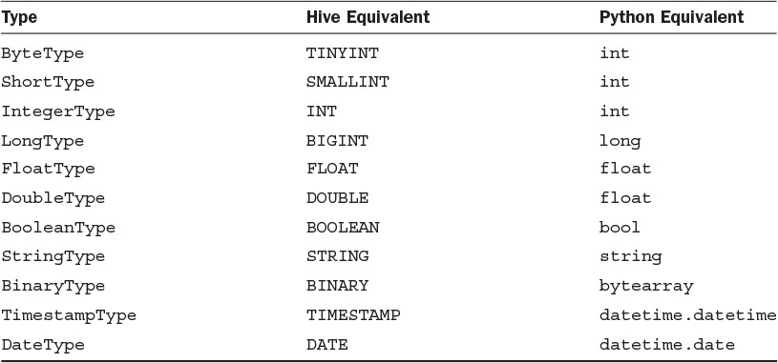
DataFrame Primitive Types

Slide 43
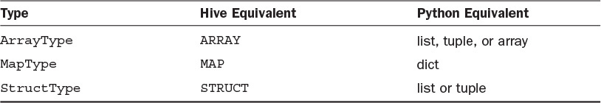
DataFrame Complex Types

Slide 44
Running SQL Queries on DataFrames
The sql() function of SparkSession enables applications to run SQL queries and returns the result as a DataFrame
SQL queries reference tables and not DataFrames…
So DataFrame provides a function to register itself as a table known to the SQL processor

Slide 45
DataFrame createOrReplaceTempView(tableName)
Register as a temporary table in the catalog.
The lifetime of the table is tied to that of the SparkSession used to create the associated DataFrame
someDataFrame.createOrReplaceTempView( "table1")

Slide 46
SparkSession sql(sqlQuery)
Returns a DataFrame representing the result of the given query
Returns: DataFrame
df1.createOrReplaceTempView(("table1")
df2 = spark.sql("SELECT field1 AS f1, field2 as f2 from table1")
df2.collect()
[Row(f1=1, f2=u'row1'), Row(f1=2, f2=u'row2'), Row(f1=3, f2=u'row3')]

Slide 47
Creating DataFrames from Files
Version 1.4 of Spark introduced a new interface used to load DataFrames from external storage systems
This interface is provided through the DataFrameReader class
The DataFrameReader interface is accessed using the SparkSession.read() function

Slide 48
SparkSession read()
Returns a DataFrameReader that can be used to read data in as a DataFrame.
Returns: DataFrameReader

Slide 49
DataFrameReader json(path, schema=None)
Loads a JSON file (one object per line) or an RDD of Strings storing JSON objects (one object per record) and returns the result as a :class`DataFrame`
JSON is a common, standard, human-readable serialization (or wire transfer) format that is often used in web service responses
Parameters:
path – string represents path to the JSON dataset, or RDD of Strings storing JSON objects.
schema – an optional StructType for the input schema
If the schema parameter is not specified, this function goes through the input once to determine the input schema.
Example
df1 = spark.read.json(‘hdfs:///user/CSP554prof/people.json')

Slide 50
DataFrameReader text(paths)
Loads a text file and returns a DataFrame with a single string column named “value”
Each line in the text file is a new row in the resulting DataFrame.
Parameters:
paths – string, or list of strings, for input path(s).
Example
df = spark.read.text('python/test_support/sql/text-test.txt')
df.collect()
[Row(value=u'hello'), Row(value=u'this')]

Slide 51
DataFrameReader Other File Types
parquet(*paths)
Loads a Parquet file, returning the result as a DataFrame
orc(path)
Loads an ORC file, returning the result as a DataFrame
Note: Currently ORC support is only available together with HiveContext
jdbc(…)
Construct a DataFrame representing the database table accessible via JDBC URL url named table and connection properties

Slide 52
Creating a DataFrame from a Hive Table
To load data from a Hive table into a Spark SQL Data-Frame, you will need a HiveContext to be created
HiveContext reads the Hive client configuration (hive-site.xml) to obtain connection details for the Hive metastore
This enables seamless access to Hive tables from a Spark application

Slide 53
Creating a DataFrame from a Hive Table
When working with Hive one must construct a HiveContext, which inherits from SparkSession, and adds support for finding tables in the MetaStore and writing queries using HQL.
# sc is an existing SparkContext.
from pyspark.sql import HiveContext
SparkSession = HiveContext(sc)
spark.sql("CREATE TABLE IF NOT EXISTS src (key INT, value STRING)")
spark.sql("LOAD DATA LOCAL INPATH ‘user/cs/kv1.txt' INTO TABLE src")
# Queries can be expressed in HiveQL.
results = spark.sql("FROM src SELECT key, value").collect()

Slide 54
DataFrame Operations
DataFrames provide a domain-specific language for data manipulation in Scala, Java, Python and R
Here we include some basic examples of structured data processing using DataFrames…

Slide 55
DataFrame Operations Note
In Python it’s possible to access a DataFrame’s columns by attribute (df.age) or by indexing (df['age'])
While accessing by attribute is convenient for interactive data exploration…
Users are encouraged to use accessing by index
Which is future proof and won’t break with column names that are also attributes on the DataFrame class

Slide 56
DataFrame Operations Examples
Assume we have a file of age and name information (person.json) encoded in JSON format
Note, for Spark SQL a JSON record must occur on one line
{"name":"Michael"}
{"name":"Andy", "age":30}
{"name":"Justin", "age":19}

Slide 57
DataFrame Operations Examples: Create a DataFrame from a File
from pyspark.sql import SparkSession
SparkSession = SparkSession(sc)
# Create the DataFrame
df = SparkSession.read.json(“hdfs:///user/CSP554prof/people.json")
The read function of the SparkSession creates a DataFrameReader whose json() function loads the indicated file into a DataFrame
On loading the DataFrame schema is inferred from the input file

Slide 58
DataFrame Operations Examples: Show the Content of the DataFrame
df.show()
Output
age name
null Michael
30 Andy
19 Justin

Slide 59
DataFrame Operations Examples: Print the Schema in a Tree Format
df.printSchema()
Ouptut
root
|-- age: long (nullable = true)
|-- name: string (nullable = true)

Slide 60
DataFrame Operations Examples: Select Only the "name" Column
df.select(‘name’).show()
or
df.select(df.name).show()
or
df.select(df[‘name’]).show()
Output
name
Michael
Andy
Justin

Slide 61
DataFrame Operations Examples: Select People Older Than 21
df.filter(df['age'] > 21).show()
Output
age name
30 Andy

Slide 62
DataFrame Operations Examples: Count People by Age
df.groupBy(df.age).count().show()
Output
age count
null 1
19 1
30 1
groupBy() returns an instance of GroupData which offers a range of aggregation functions including oount()

Slide 63
DataFrame describe(*cols)
Computes statistics for numeric columns.
This include count, mean, stddev, min, and max
If no columns are given, this function computes statistics for all numerical columns

Slide 64
DataFrame describe(*cols)
>>> df.describe().show()
+-------+------------------+
|summary| age|
+-------+------------------+
| count | 2|
| mean | 3.5|
| stddev | 2.1213203435596424|
| min| 2|
| max| 5|
+-------+------------------+
>>> df.describe(['age', 'name']).show()
+-------+------------------+-----+
|summary| age| name|
+-------+------------------+-----+
| count| 2| 2|
| mean| 3.5| null|
| stddev| 2.1213203435596424| null|
| min| 2|Alice|
| max| 5| Bob|
+-------+------------------+-----+

Slide 65
DataFrame distinct()
Returns a new DataFrame containing the distinct rows in this DataFrame
df.distinct().count()
2

Slide 66
DataFrame drop(col)
Returns a new DataFrame that drops the specified column
Parameters:
col – a string name of the column to drop, or a Column to drop.

Slide 67
DataFrame drop(*cols)
>>> df.drop('age').collect()
[Row(name=u'Alice'), Row(name=u'Bob')]
>>> df.drop(df.age).collect()
[Row(name=u'Alice'), Row(name=u'Bob')]
>>> df.join(df2, df.name == df2.name, 'inner').drop(df.name).collect()
[Row(age=5, height=85, name=u'Bob')]
>>> df.join(df2, df.name == df2.name, 'inner').drop(df2.name).collect()
[Row(age=5, name=u'Bob', height=85)]

Slide 68
DataFrame dropna(how='any', thresh=None, subset=None)
Returns a new DataFrame omitting rows with null values
Parameters:
how – ‘any’ or ‘all’. If ‘any’, drop a row if it contains any nulls. If ‘all’, drop a row only if all its values are null.
thresh – int, default None If specified, drop rows that have less than thresh non-null values. This overwrites the how parameter.
subset – optional list of column names to consider.
>>> df4.na.drop().show()
+---+------+-----+
|age|height| name|
+---+------+-----+
| 10| 80|Alice|
+---+------+-----+

Slide 69
DataFrame dtypes
dtypes
Returns all column names and their data types as a list
>>> df.dtypes
[('age', 'int'), ('name', 'string')]

Slide 70
DataFrame fillna(value, subset=None)
Replace null values
Parameters:
value – int, long, float, string, or dict. Value to replace null values with. If the value is a dict, then subset is ignored and value must be a mapping from column name (string) to replacement value. The replacement value must be an int, long, float, or string.
subset – optional list of column names to consider
Columns specified in subset that do not have matching data type are ignored
For example, if value is a string, and subset contains a non-string column, then the non-string column is simply ignored.

Slide 71
DataFrame filter(condition)
Filters rows using the given condition.
Parameters:
condition – a Column of types.BooleanType or a string of SQL expression

Slide 72
DataFrame filter(condition)
>> df.filter(df.age > 3).collect()
[Row(age=5, name=u'Bob')]
>>> df.where(df.age == 2).collect()
[Row(age=2, name=u'Alice')]
>>> df.filter("age > 3").collect()
[Row(age=5, name=u'Bob')]
>>> df.where("age = 2").collect()
[Row(age=2, name=u'Alice')]

Slide 73
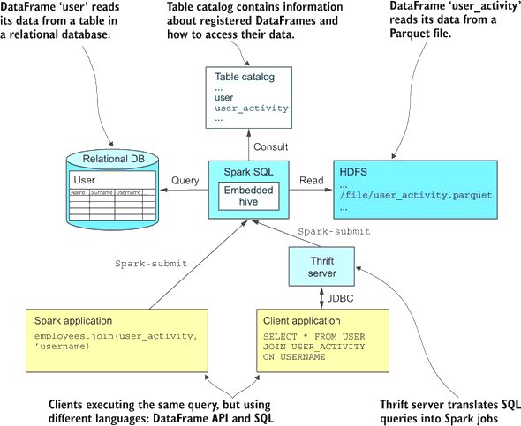

Slide 74
DataFrame first()
Returns the first row as a Row.
>>> df.first()
Row(age=2, name=u'Alice')

Slide 75
DastaFrame foreach()
Applies the f function to all Row of this DataFrame.
>>> def f(person):
... print(person.name)
>>> df.foreach(f)

Slide 76
DataFrame groupBy()
Groups the DataFrame using the specified columns, so we can run aggregation on them
Parameters: cols – list of columns to group by. Each element should be a column name (string) or an expression (Column).
>>> df.groupBy().avg().collect()
[Row(avg(age)=3.5)]
>>> df.groupBy('name').agg({'age': 'mean'}).collect()
[Row(name=u'Alice', avg(age)=2.0), Row(name=u'Bob', avg(age)=5.0)]
>>> df.groupBy(df.name).avg().collect()
[Row(name=u'Alice', avg(age)=2.0), Row(name=u'Bob', avg(age)=5.0)]
>>> df.groupBy(['name', df.age]).count().collect()
[Row(name=u'Bob', age=5, count=1), Row(name=u'Alice', age=2, count=1)]

Slide 77
DataFrame head(n=None)
Returns the first n rows.
Parameters
n – int, default 1. Number of rows to return.
Returns
If n is greater than 1, return a list of Row. If n is 1, return a single Row.
>>> df.head()
Row(age=2, name=u'Alice')
>>> df.head(1)
[Row(age=2, name=u'Alice')]

Slide 78
DataFrame join(other, on=None, how=None)
Joins with another DataFrame, using the given join expression.
Parameters:
other – Right side of the join
on – a string for join column name, a list of column names, a join expression (Column) or a list of Columns
If on is a string or a list of string indicating the name of the join column(s), the column(s) must exist on both sides, and this performs an inner equi-join.
how – str, default ‘inner’. One of inner, outer, left_outer, right_outer, leftsemi

Slide 79
DataFrame join(other, on=None, how=None)
.>>> df.join(df2, df.name == df2.name, 'outer').select(df.name, df2.height).collect()
[Row(name=None, height=80), Row(name=u'Alice', height=None), Row(name=u'Bob', height=85)]
>>> cond = [df.name == df3.name, df.age == df3.age]
>>> df.join(df3, cond, 'outer').select(df.name, df3.age).collect()
[Row(name=u'Bob', age=5), Row(name=u'Alice', age=2)]
>>> df.join(df2, 'name').select(df.name, df2.height).collect()
[Row(name=u'Bob', height=85)]
>>> df.join(df4, ['name', 'age']).select(df.name, df.age).collect()
[Row(name=u'Bob', age=5)]

Slide 80
DataFrame map(f)
Returns a new RDD by applying a the f function to each Row.
>>> df.map(lambda p: p.name).collect()
[u'Alice', u'Bob']

Slide 81
DataFrame printSchema()
printSchema()
Prints out the schema in the tree format.
>>> df.printSchema()
root
|-- age: integer (nullable = true)
|-- name: string (nullable = true)

Slide 82
DataFrame select(*cols)
Projects a set of expressions and returns a new DataFrame.
Parameters:
cols – list of column names (string) or expressions (Column). If one of the column names is ‘*’, that column is expanded to include all columns in the current DataFrame.
>>> df.select('*').collect()
[Row(age=2, name=u'Alice'), Row(age=5, name=u'Bob')]
>>> df.select('name', 'age').collect()
[Row(name=u'Alice', age=2), Row(name=u'Bob', age=5)]
>>> df.select(df.name, (df.age + 10).alias('age')).collect()
[Row(name=u'Alice', age=12), Row(name=u'Bob', age=15)]

Slide 83
DataFrame sort(*cols, **kwargs)
Returns a new DataFrame sorted by the specified column(s).
Parameters:
cols – list of Column or column names to sort by.
ascending – boolean or list of boolean (default True).
>>> df.sort("age", ascending=False).collect()
[Row(age=5, name=u'Bob'), Row(age=2, name=u'Alice')]

